Slide 1
Optimizing Mortgage Targeting Strategies Using Big Data Analytics
Notes:
Today, I'll be presenting the results of a project focused on determining which customers should be given a mortgage loan. As we all know, mortgage loans are a significant part of the banking industry and can greatly impact the financial stability of both the bank and the customer.
The goal was to develop a model that could accurately predict which customers are suitable for a mortgage loan based on a range of variables, such as age, income, and employment status. By doing so, we hope to improve the efficiency and effectiveness of the loan approval process, while also reducing the risk of loan defaults.

Slide 2

overview
Exploratory Data Analysis (EDA)
Modelling
Recommendations
Notes:
To give a little overview:
During the EDA stage, we explore and summarize the data to identify any patterns, trends, or outliers that can inform our modelling and decision-making. This process involves visualizations, summary statistics, and data cleaning techniques to ensure the data is ready for modelling.
In the modelling stage, we use machine learning algorithms to predict mortgage customer behavior based on the data we collected in the EDA stage.
Based on the results of our modelling, we make recommendations to the business on how to optimize their mortgage targeting strategy. We suggest focusing on certain customer segments, while avoiding others.

Slide 3

The data
Size and dimensionality
13 columns
Around 24 thousand rows
Different column types
Notes:
During our analysis, we used a dataset that includes information about customers applying for mortgage loans. The dataset included 13 columns, such as age, employment type, date income, education, and current balance.
It has also been found that there was a significant imbalance between the number of customers who had a mortgage loan and the number of those who didn't. Only around 1.2% of customers had a loan, at the time of examining the dataset. This imbalance will need to be addressed when creating a predictive model.

Slide 4
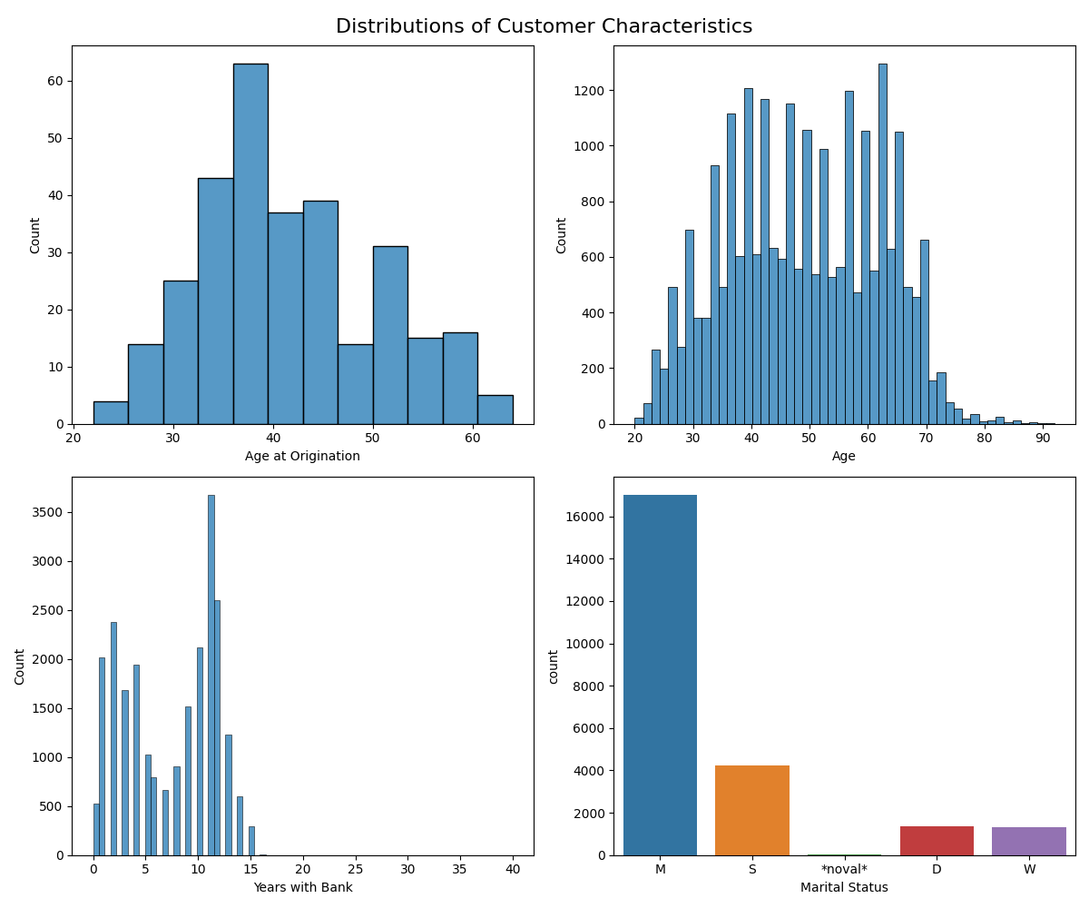
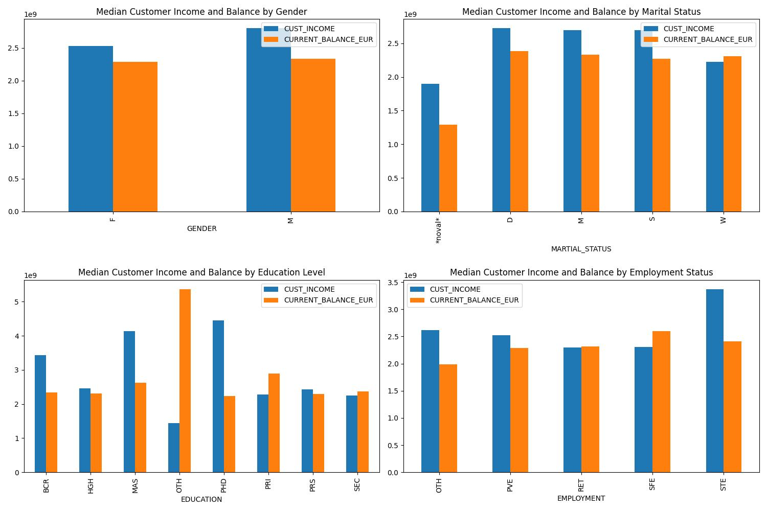
Abstractions and visualizations
Notes:
From this we can see that a very large amount of people have been with the bank for more than 5 years, they are mostly married and around 50 years old on average.
People with short term employment earn more on average, the genders are pretty much equal, People with PHDS have the highest median salary and so on.

Slide 5
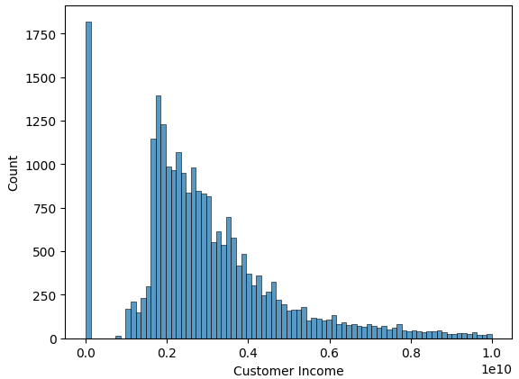
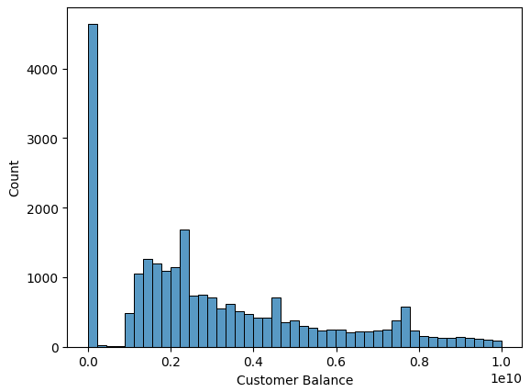
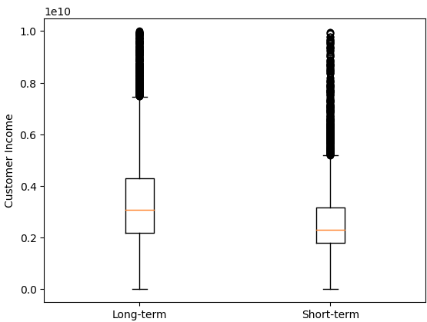
Notes:
Here we can see the distributions of customer income and balance
We can notice that there is a significant number of customers that earn a very disproportionately small amount of money, in comparison to the rest of the dataset, as well as those who have 0 EUROS balance on their account.
People who’ve been with the bank for more than 10 years have higher median income than those that have been with the bank for less than 5 years. It is important to note that there are a lot of outliers in each category, which are marked with circles on the violin chart.

Slide 6
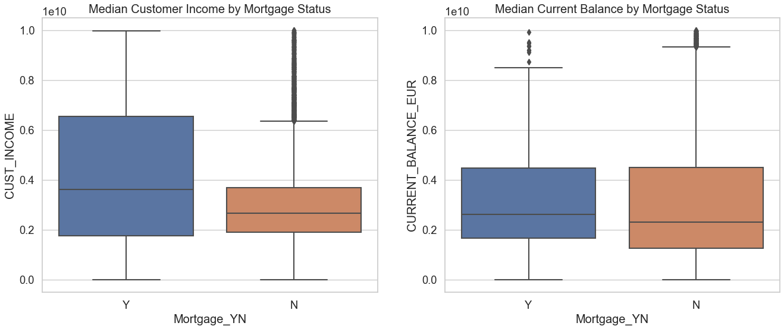
Notes:
From these violin plots we can conclude that on average, the person who has a mortgage loan has a wider distribution, so it might be something to watch out for in the modelling part.
On the current balance side of things, it is almost identical, making it difficult to make assumptions.

Slide 7

Modelling
Data cleaning
Feature engineering
Clustering
Model selection
Training
Evaluation
Optimization
Interpretation
Recommendations
Notes:
Data cleaning: Remove any duplicate or irrelevant data, handle missing values and outliers, and ensure the data is in the correct format for modelling.
Feature engineering: Create new features from the existing ones, and select the most relevant features for the modelling task. Here some encoding was done to turn categorical variables into ones that the models can recognize, some irrelevant data was dropped, a new feature called EMPLOYMENT_STABILITY was created and with principal component analysis and clustering the dimensionality of the data was reduced somewhat.
Clustering: Use techniques like K-means clustering to identify groups of similar data points that can be used as new features in the modelling process.
Model selection: Choose an appropriate machine learning model based on the nature of the problem and the characteristics of the data. Since this is a classification task, and we have 2 different outcomes (0 for doesn’t have mortgage, 1 for does have mortgage), I’ve chosen a machine learning algorithm called Isolation forest that I’m familiar with, and it yielded the best results.
Model training: Fit the chosen model to the training data.
Model evaluation: Use performance metrics to evaluate the model's performance on the testing set.
Model interpretation: Understand the model's behavior and decision-making process to extract valuable insights and identify areas for improvement. Since the isolation forest algorithm is a sort of black box, it is difficult to interpret.
Recommendations: Make suggestions based on the results of the best performing model.

Slide 8

Model selection
Isolation Forest
Decision Tree Classifier
K - means
Notes:
These are the models I’ve used, I won’t go into too much technicality but the one that performed the best was the Isolation forest algorithm as it made the least amount of mistakes, when I tuned it

Slide 9
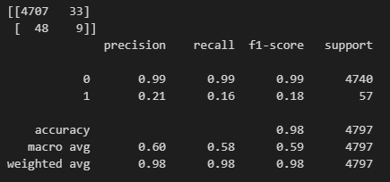

Results comparison
Isolation Forest results Decision Tree Classifier results
Notes:
The isolation forest model is good for anomaly detection, so I thought this could be a good time to try and use it. The main perk of it is that you can set the percentage of anomalies that show up, so you can tame the model from making too many mistakes, essentially.
This model is quite good at recognizing which customers aren’t good candidates for a mortgage loan, however it does make mistakes, though they are minimized in comparison to an algorithm such as decision tree classifier in which it is much harder to tame the number of classifications of each category. While the Isolation forest algorithm managed to classify almost perfectly all of the potentially bad loaners as what they are, it missed opportunities.
The question of balancing in this type of problem is the most important thing, and here’s why:
Balancing false positives and false negatives is important because the costs of each type of error can be different, and the relative costs may depend on the specific context of the problem. For example, in the case of mortgage lending, a false negative (denying a loan to a good borrower) could lead to missed opportunities for the lender to make money, while a false positive (granting a loan to a bad borrower) could result in financial losses for the lender. However, the relative costs of these errors may depend on factors such as the interest rate, the size of the loan, and the creditworthiness of the borrower.
In some cases, it may be more important to minimize false positives (e.g., in cases where the cost of a granting a loan to a bad borrower is very high), while in other cases it may be more important to minimize false negatives (e.g., in cases where missed opportunities are more costly than false positives).

Slide 10

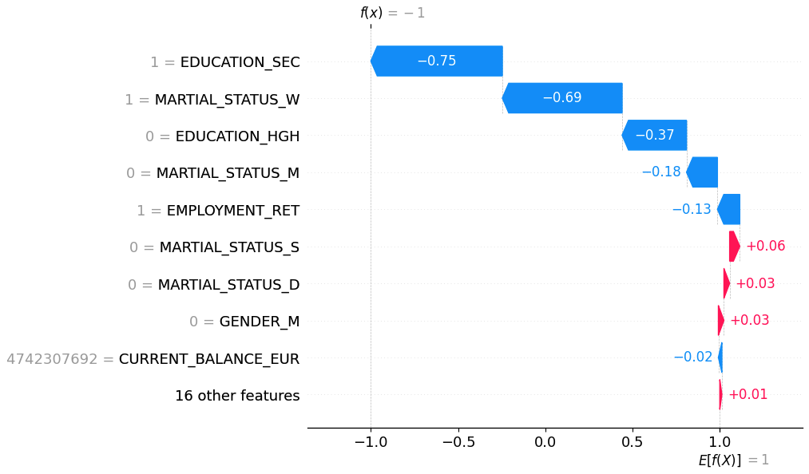
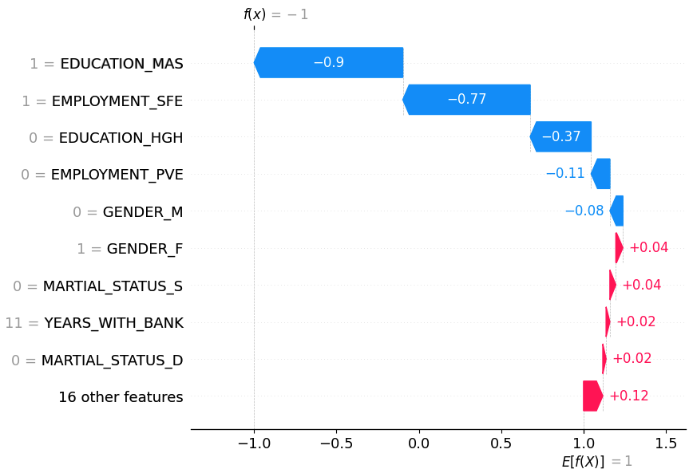
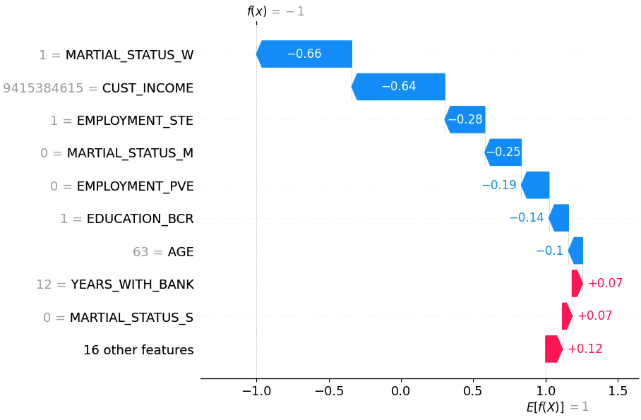
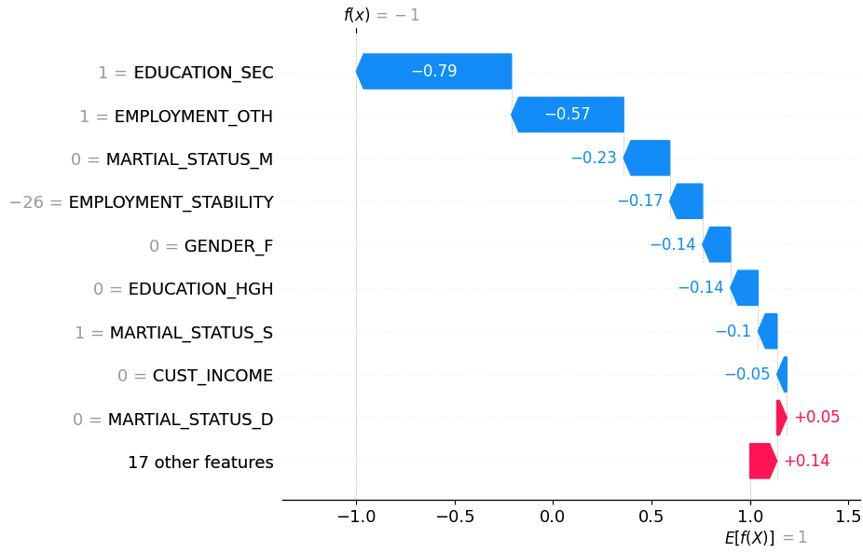
Potential customers recommendations
Notes:
This is the customer with id 80067. This person has been identified as a potentially good candidate by the Isolation forest algorithm. While isolation forest is a black box algorithm, we can use external libraries such as SHAP to bring at least some of the explanations back to us. In this case, the blue arrows contribute to it being a good candidate, while red ones contribute to it perhaps not being an adequate person to give a loan to.
The columns that contributed the most were the fact that this person is a widow, and that they have SEC education, while not having high education. Similar story is told at other points as well. Sometimes income plays a valid role, sometimes it’s marital status and so on. However it is important to keep in mind that SHAP is only making assumptions to which column is making the most impact, and it does make mistakes sometimes.

Slide 11
Conclusion?
Let’s jump to the code real quick

